Slide 1
The Sabbath Question

Slide 2
Luke 14: 1- 6

Slide 3
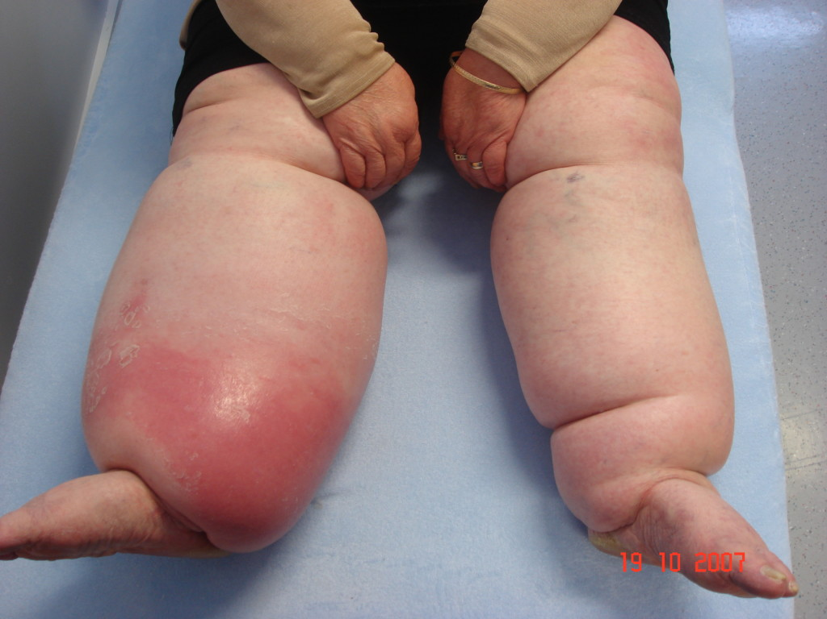
Dropsy

Slide 4
Jesus accused of Sabbath breaking
Matthew – 2 times – 12:1-7 and 12:8-12
Mark – 2 times – 2:23-28 and 3:2-4
Luke – 4 times – 6:1-5 and 6:6-11 and 13:10-16 and14:1-6
John – 3 times – 5:9-16 and 7:22-23 and 9:14-16

Slide 5
Jesus accused of Sabbath breaking
Incident 1: Disciples picking grain while walking through a field
Incident 2: Jesus heals man with a withered hand
These show up in Matthew, Mark, and Luke

Slide 6
Jesus accused of Sabbath breaking
Incident 3: Jesus heals woman bent double for 18 years
Incident 4: Jesus heals man with dropsy
Both of these are in Luke
Incident 5: Jesus heals a man, ill for 38 years by pool of Bethsaida
Incident 6: Jesus heals a man blind from birth.
Both of these are in John, one incident referred to in 2 different passages.

Slide 7
Matthew 12:7
But if you had known what this means, ---quote from Old Testament goes in here-you would not have condemned the innocent.

Slide 8
Matthew 12:7
But if you had known what this means, “I desire compassion and not sacrifice” you would not have condemned the innocent.

Slide 9
Hosea 4
There is no faithfulness, or kindness, or knowledge of God in the land…
There is swearing, deception, murder, stealing, and adultery…
Therefore the land mourns…

Slide 10
Hosea 2:11
“I will also put an end to all her gaiety, her feasts, her new moons, her Sabbaths and all her festal assemblies.”

Slide 11
Hosea 6
What shall I do with you, O Judah?
For your kindness is like a morning cloud and like the dew which goes away early. Therefore I have hewn them in pieces by the prophets. I have slain them by the words of my mouth. And the judgements on you are like the light that goes forth. For I delight in kindness rather than sacrifice. And in the knowledge of God rather than burnt offerings.

Slide 12
“kindness”
lovingkindness, steadfast love, enduring love, unfailing love
In NT, translated with a word that we translate as compassion or mercy

Slide 13
Practical thoughts on the Sabbath
Saturday or Sunday?
John 4:19-24
Romans 14:5-10

Slide 14
Practical thoughts on the Sabbath
Saturday or Sunday?
John 4:19-24
Romans 14:5-10
Be convinced in your own mind
Don’t judge your brother

Slide 15
Practical thoughts on the Sabbath
2. Sabbath starts in the evening.

Slide 16
Practical thoughts on the Sabbath
3. The Sabbath is about trust and contentment.
The Sabbath helps work against coveting.

Slide 17
Practical thoughts on the Sabbath
4. Rest can be of body or of mind.

Slide 18
Practical thoughts on the Sabbath
5. By the way, the 5 day work week, has Sabbath built in.

Slide 19
Practical thoughts on the Sabbath
6. The commandment for the Sabbath uses the phrase, “a sabbath of the Lord” so we associate Sabbath with worship. Sabbath has both a rest element and a set apart to the Lord element.

Slide 20
Practical thoughts on the Sabbath
7. You might have to wrestle with your understanding and practical living of the Sabbath.

Slide 21
This page intentionally left blank

